Slide 1
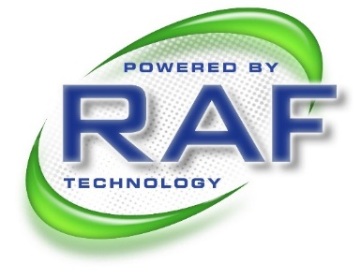
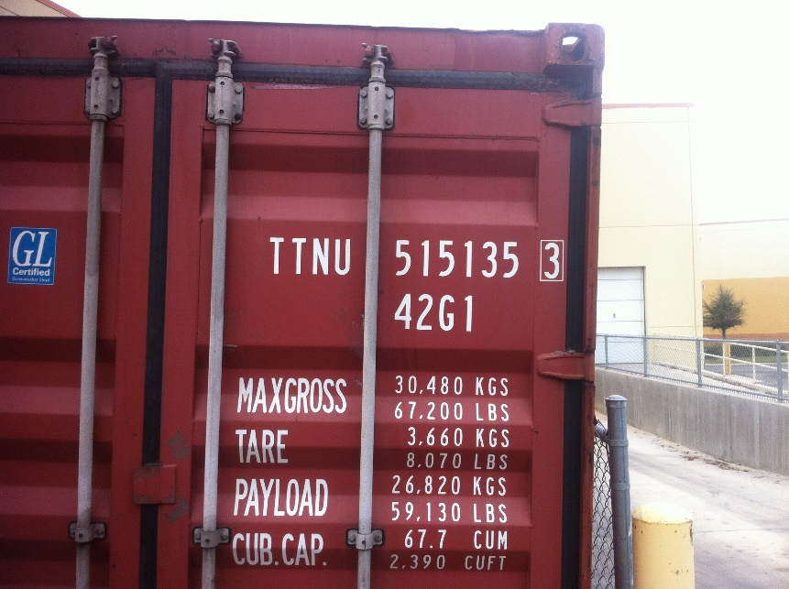
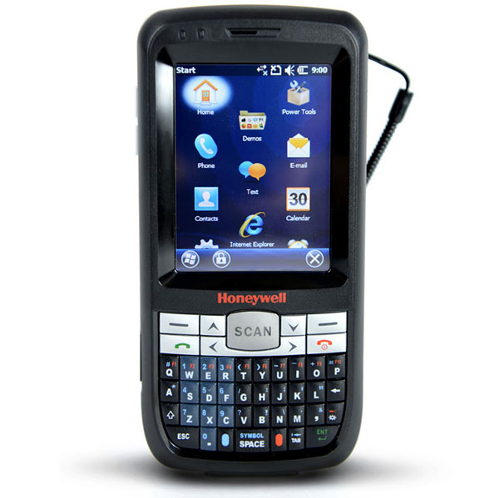
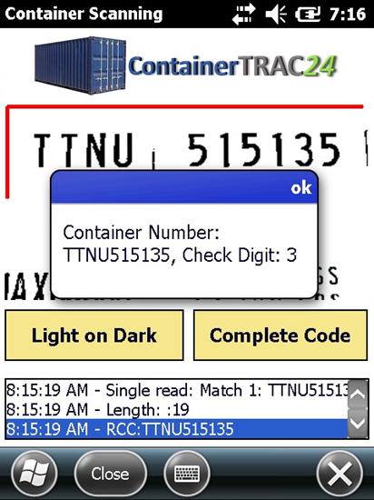

Argosy
Intermodal
Enhancing Port & Yard Efficiency
( A GAME CHANGING APPROACH BY LEVERAGING MOBILE AUTOMATION)

Slide 2
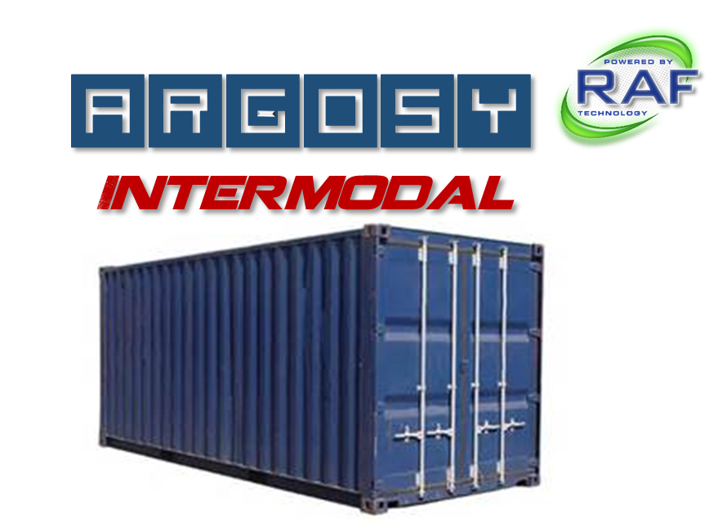
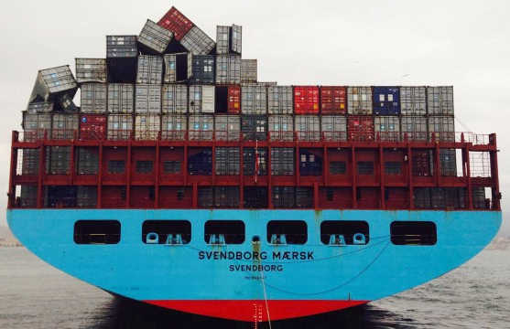
Shipping Container Statistics
Shipping containers account for about 90% of the non bulk cargo transported in the world
Last year the world’s container ports moved 560 million 20-foot containers
There are currently over 17 million shipping containers in the world
Every day 5 or 6 million containers are concurrently shipping around the world on vessels, trucks, and trains.
In total, they make around 200 million trips a year.
On average a single container will have up to 13 chain of custody transfer events per shipment. Each event will require a container to be tracked and inspected!

Slide 3
Why OCR should be part of your solution
Today’s OCR technology provides visibility not only to equipment presence at key points within the supply chain but also the recording of an object’s visual condition at the time of handling.
Key ROI benefits recognized using OCR for Intermodal shipping:
Network asset visibility - associated with multiple operations or nodes in a widespread network
Operational Control – improves productivity and efficiency
Safety – reduces attendant inventory time in the yard
Security – uniquely identifies each asset and provides high resolution images to detect security seals, locked doors, holes, etc.

Slide 4

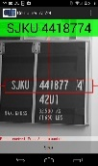
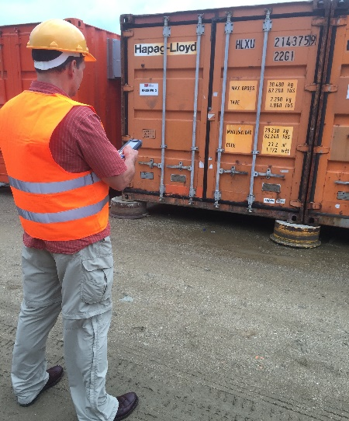
Markets supported by mobile OCR
Vessel Operating Common Carriers (VOCCs)
Intermodal Terminal Operators
Near Port and Container Logistics
Rail yards
RORO Facilities
Chassis Pools
Customs and Border Protection Agencies
Security Firms

Slide 5
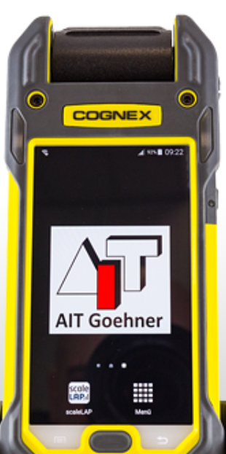

RAF’s Mobile OCR Solution
Can easily be integrated into existing depot management systems through a simple API
Is a low cost alternative to fixed OCR solutions
Provides a Thick and Thin client SDK which supports a wide variety of mobile devices such as PC’s, tablets, smartphones, and mobile computers
Supports all major operating systems such as Android, IOS, and Windows
Uniquely packaged to provide real-time in- field data (e.g. OCR results, GPS coordinates, pictures, signature capture, electronic mark-sense forms, etc…)

Slide 6
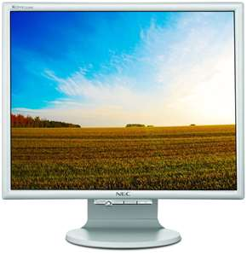
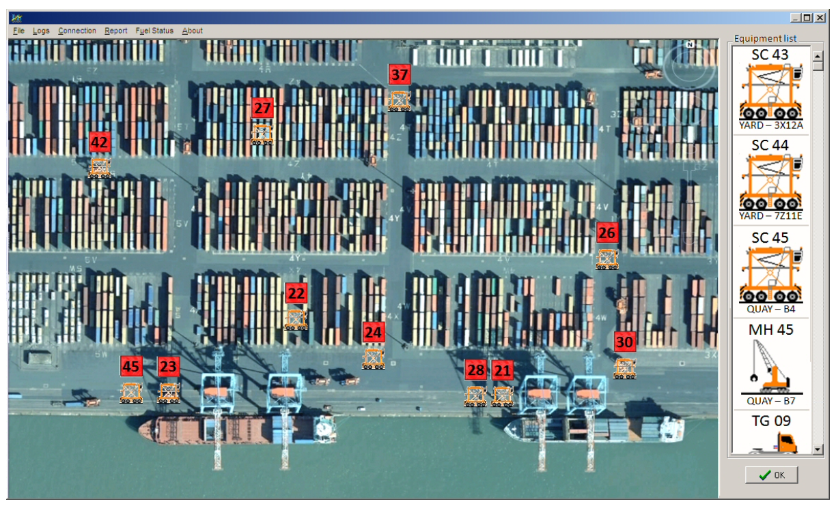
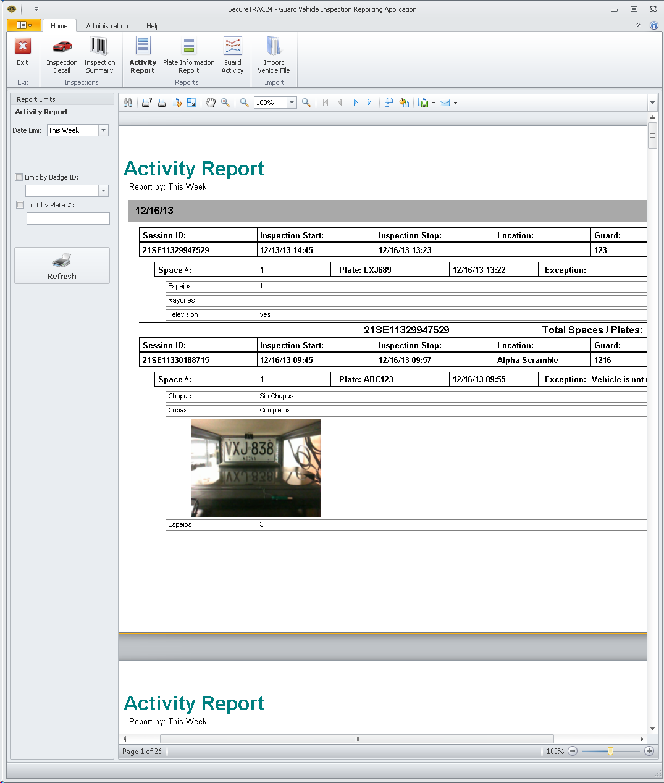
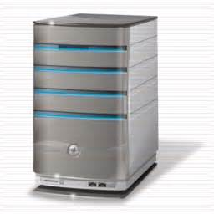


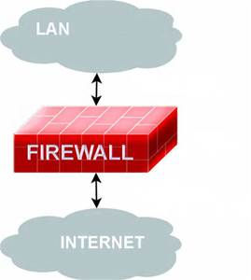

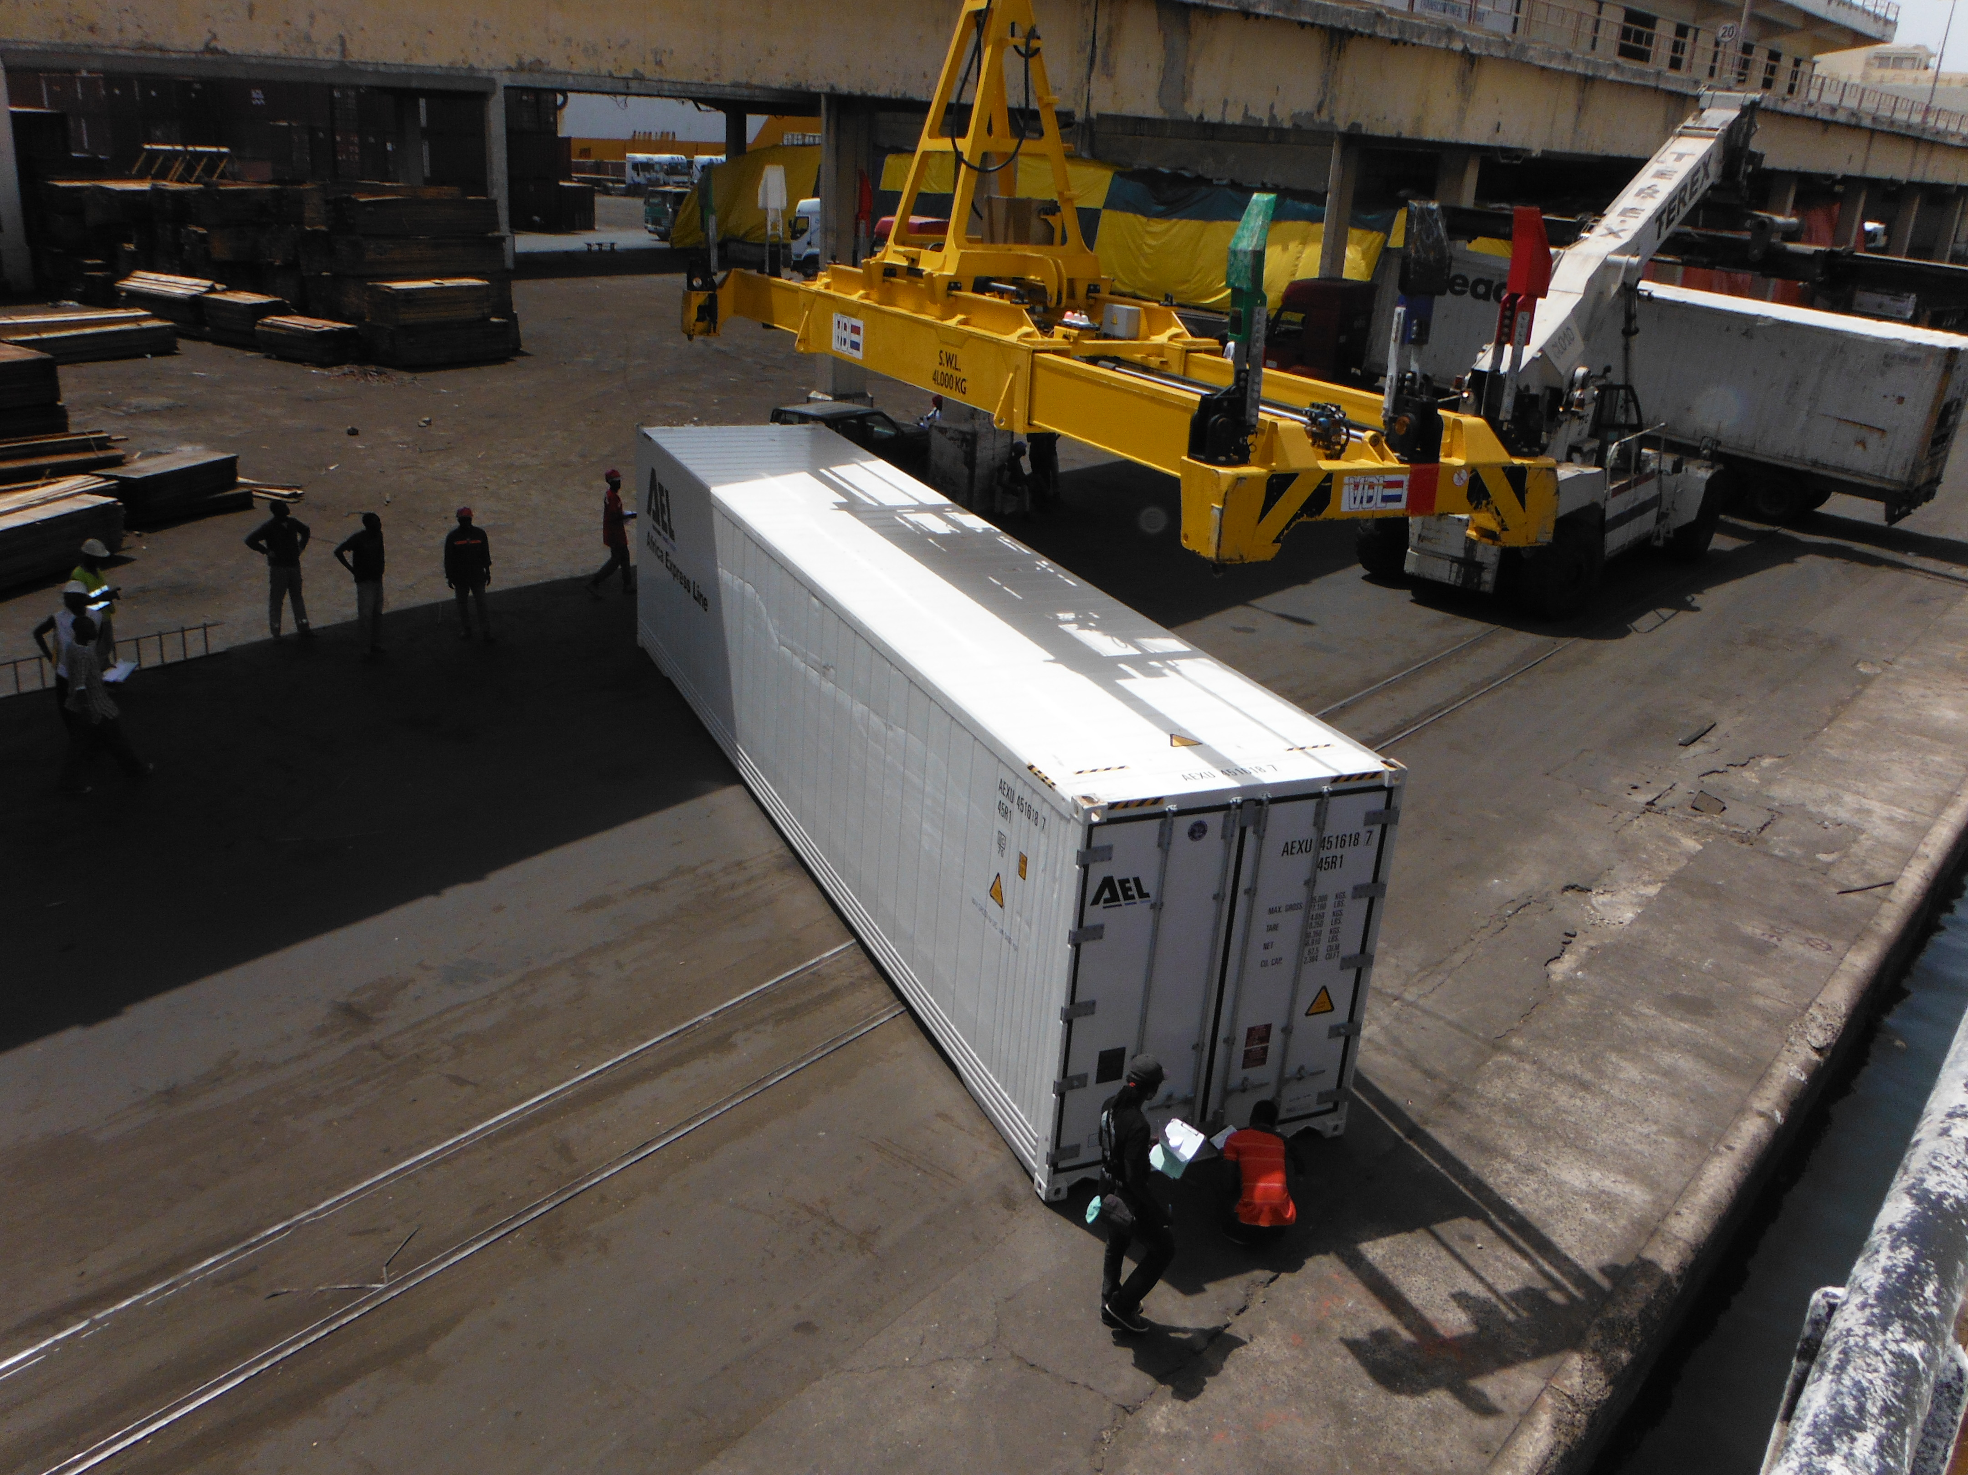
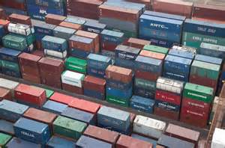
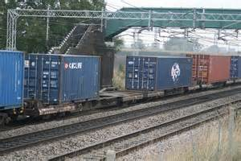
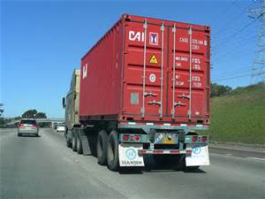

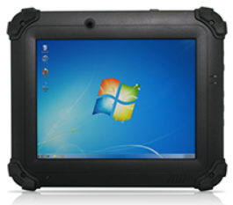
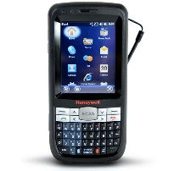
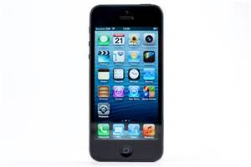



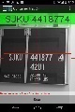
Network Workflow & Integration Overview
Web Service
Tracking System
ISO Code Validation from Manifest Data
*RAF’s solution is hardware agnostic and can operate on any device for thick and thin client applications
Port
Container yard
Train
Truck
Container Scan #1
Container Scan #2
Container Scan #4
Container Scan #3

Slide 7
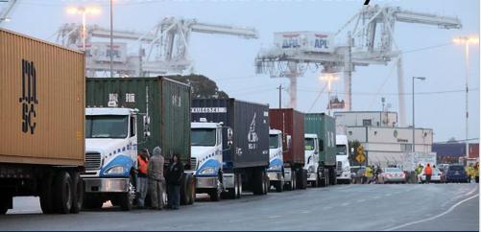
Use case example #1 (OCR Containers & Safety Seals)
Problem:
Manual entry of data at Gate-in
On average requires about 4 minutes to complete each vehicle check-in
Is labor intensive and generally requires two employee’s to complete the task at each gate
Generates high error rates (most common errors are recording the wrong container ID or Safety Seal ID)
Negatively impacts turnaround times
Creates gate congestion (Especially during Peak)

Slide 8
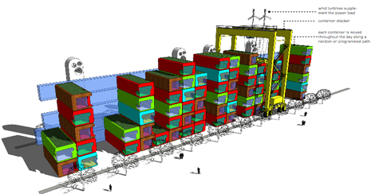
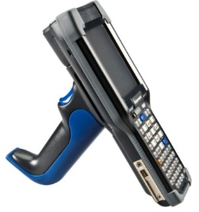

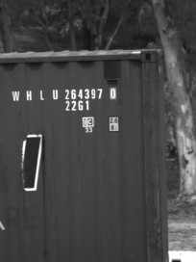
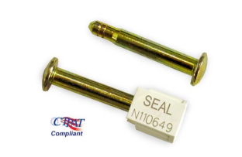
Use case example #1 (OCR Containers & Safety Seals)
Solution:
The inspector uses OCR to capture the following:
Container ISO Code
Dimensions
Security Seal
GPS coordinate data
Provides high resolution images of the physical container
Increase gate productivity for labor and throughput by at least 35% or greater
ISO6346 Code
Security Seals
ISO/PAS 17712
ISO Code Imaged
OCR Result

Slide 9
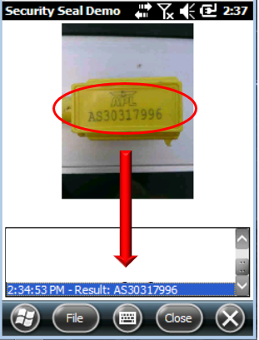
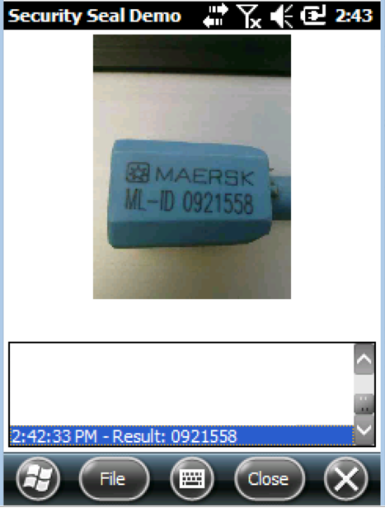
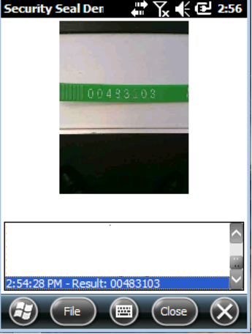
OCR safety seal scanning
Wide variety of shapes and styles supported

Slide 10
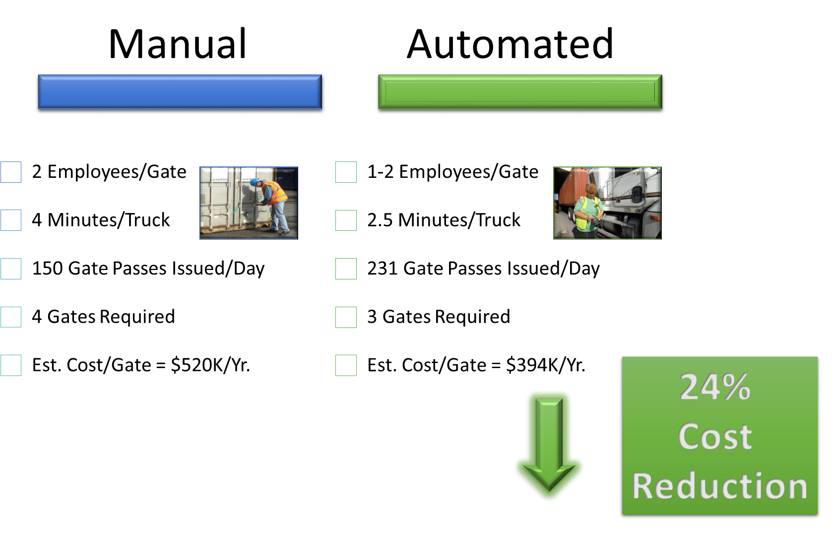

ROI Benefit
Side-by-Side comparison between a manual gate-in process verses automated using Argosy Intermodal OCR software:

Slide 11
Use case example #2 (Safety seal authentication)
(mouse over to launch hyperlink)
Current Challenges and Threats:
https://www.securingindustry.com/clothing-and-accessories/cargo-thieves-increasingly-using-3d-printing-says-g4s/s107/a2785/
According to G4S in a recent May 16, 2016 article published in Security Industry criminals are using 3D-Printed security devices to disguise cargo thefts.
New technology allows thieves to make counterfeit copies of devices such as ISO 17712 high security cargo seals and locks/padlocks in as little as 10 minutes allowing them to hide signs of tampering making it difficult to identify the location or time of the theft.
“It is important that companies recognize that this new threat means they need to improve their supply chain security and lower their vulnerability to this emerging treat”

Slide 12
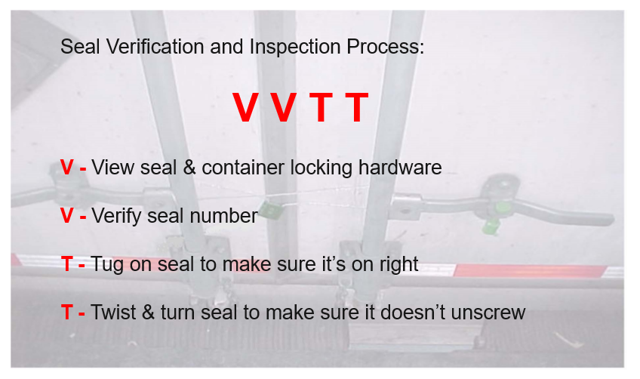
Use case example #2 (Safety seal authentication)
Current Manual Approach to Inspecting Seals

Slide 13
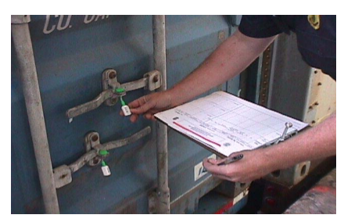
Use case example #2 (Safety seal authentication)
Key Manual Points of Seal Inspection
▪Scratches
▪Burn/Weld Marks
▪Tampered Bolts/Rivets
▪Fresh Grease
▪Fresh Paint
▪Silicone
▪Fiberglass Patchwork
▪Odor Masking Substances
▪After Market Modifications

Slide 14
Use case example #2 (Safety seal authentication)
Solution:
RAF along with our affiliated sister company Authentect have developed a solution which can identify and authenticate a safety seal for automated track-and-trace even in the absence of added identifying information.
Provides a complete closed loop
track & trace system easily
integrated into your current YMS
Seal
Authentication
Container

Slide 15

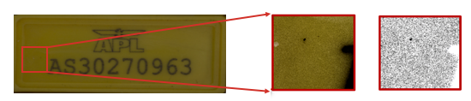
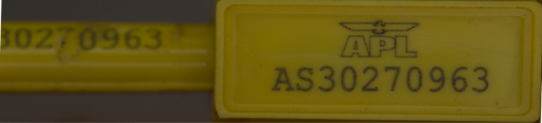

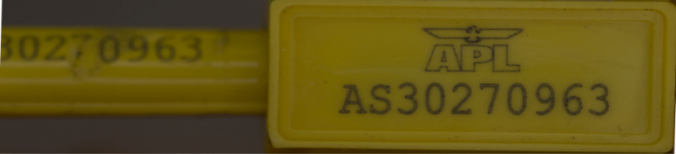
The Featureprint™
Instantly confirms an object’s identity, authenticity, and pedigree at any location
A Featureprint is unique
As every person has unique fingerprints, every object has unique surface properties that make it distinct from all other similar items.
Our patented Featureprinting process extracts minute hyperspectral details that clearly distinguish even objects apparently identical to the human eye. This hyperspectral image transformation collects and processes information from across the electromagnetic spectrum to uniquely classify and interrelate all the pixels of the region of interest and establishes a unique, verifiable identity of the object.
Approximate representation of what the computer sees
Seal Authentication:

Slide 16


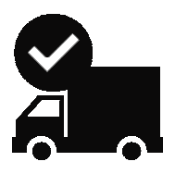

Workflow Overview
INDUCTION
AUTHENTECT
CLOUD SERVICES
AUTHENTICATION
TRACK & TRACE
Capture reference images and data at the point of provenance.
Our cloud platform extracts the Featureprint from the image. Featureprints are stored and available to be referenced for authentication.
Smart, connected imaging devices facilitate our authentication services.
Seals can be tracked through your system with each Featureprint verification.

Slide 17

Use case example #3 (Verifying manifest records)
OCR can also be used for IMO/Hazardous Placard Detection
International Maritime Dangerous Goods (IMDG) Code Recognition (example)
Class 1 – Explosives
Class 2 – Gases
Class 3 – Flammable Liquids
Class 4 – Flammable Solids
Class 5 – Oxidizing substances and organic peroxides
Class 6 – Toxic and infectious substances
Class 7 – Radioactive material
Class 8 – Corrosive substances
Class 9 – Miscellaneous dangerous substances and articles

Slide 18
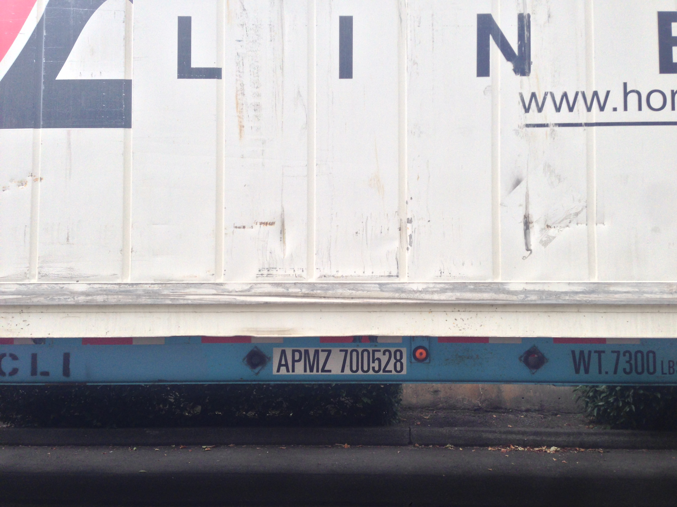
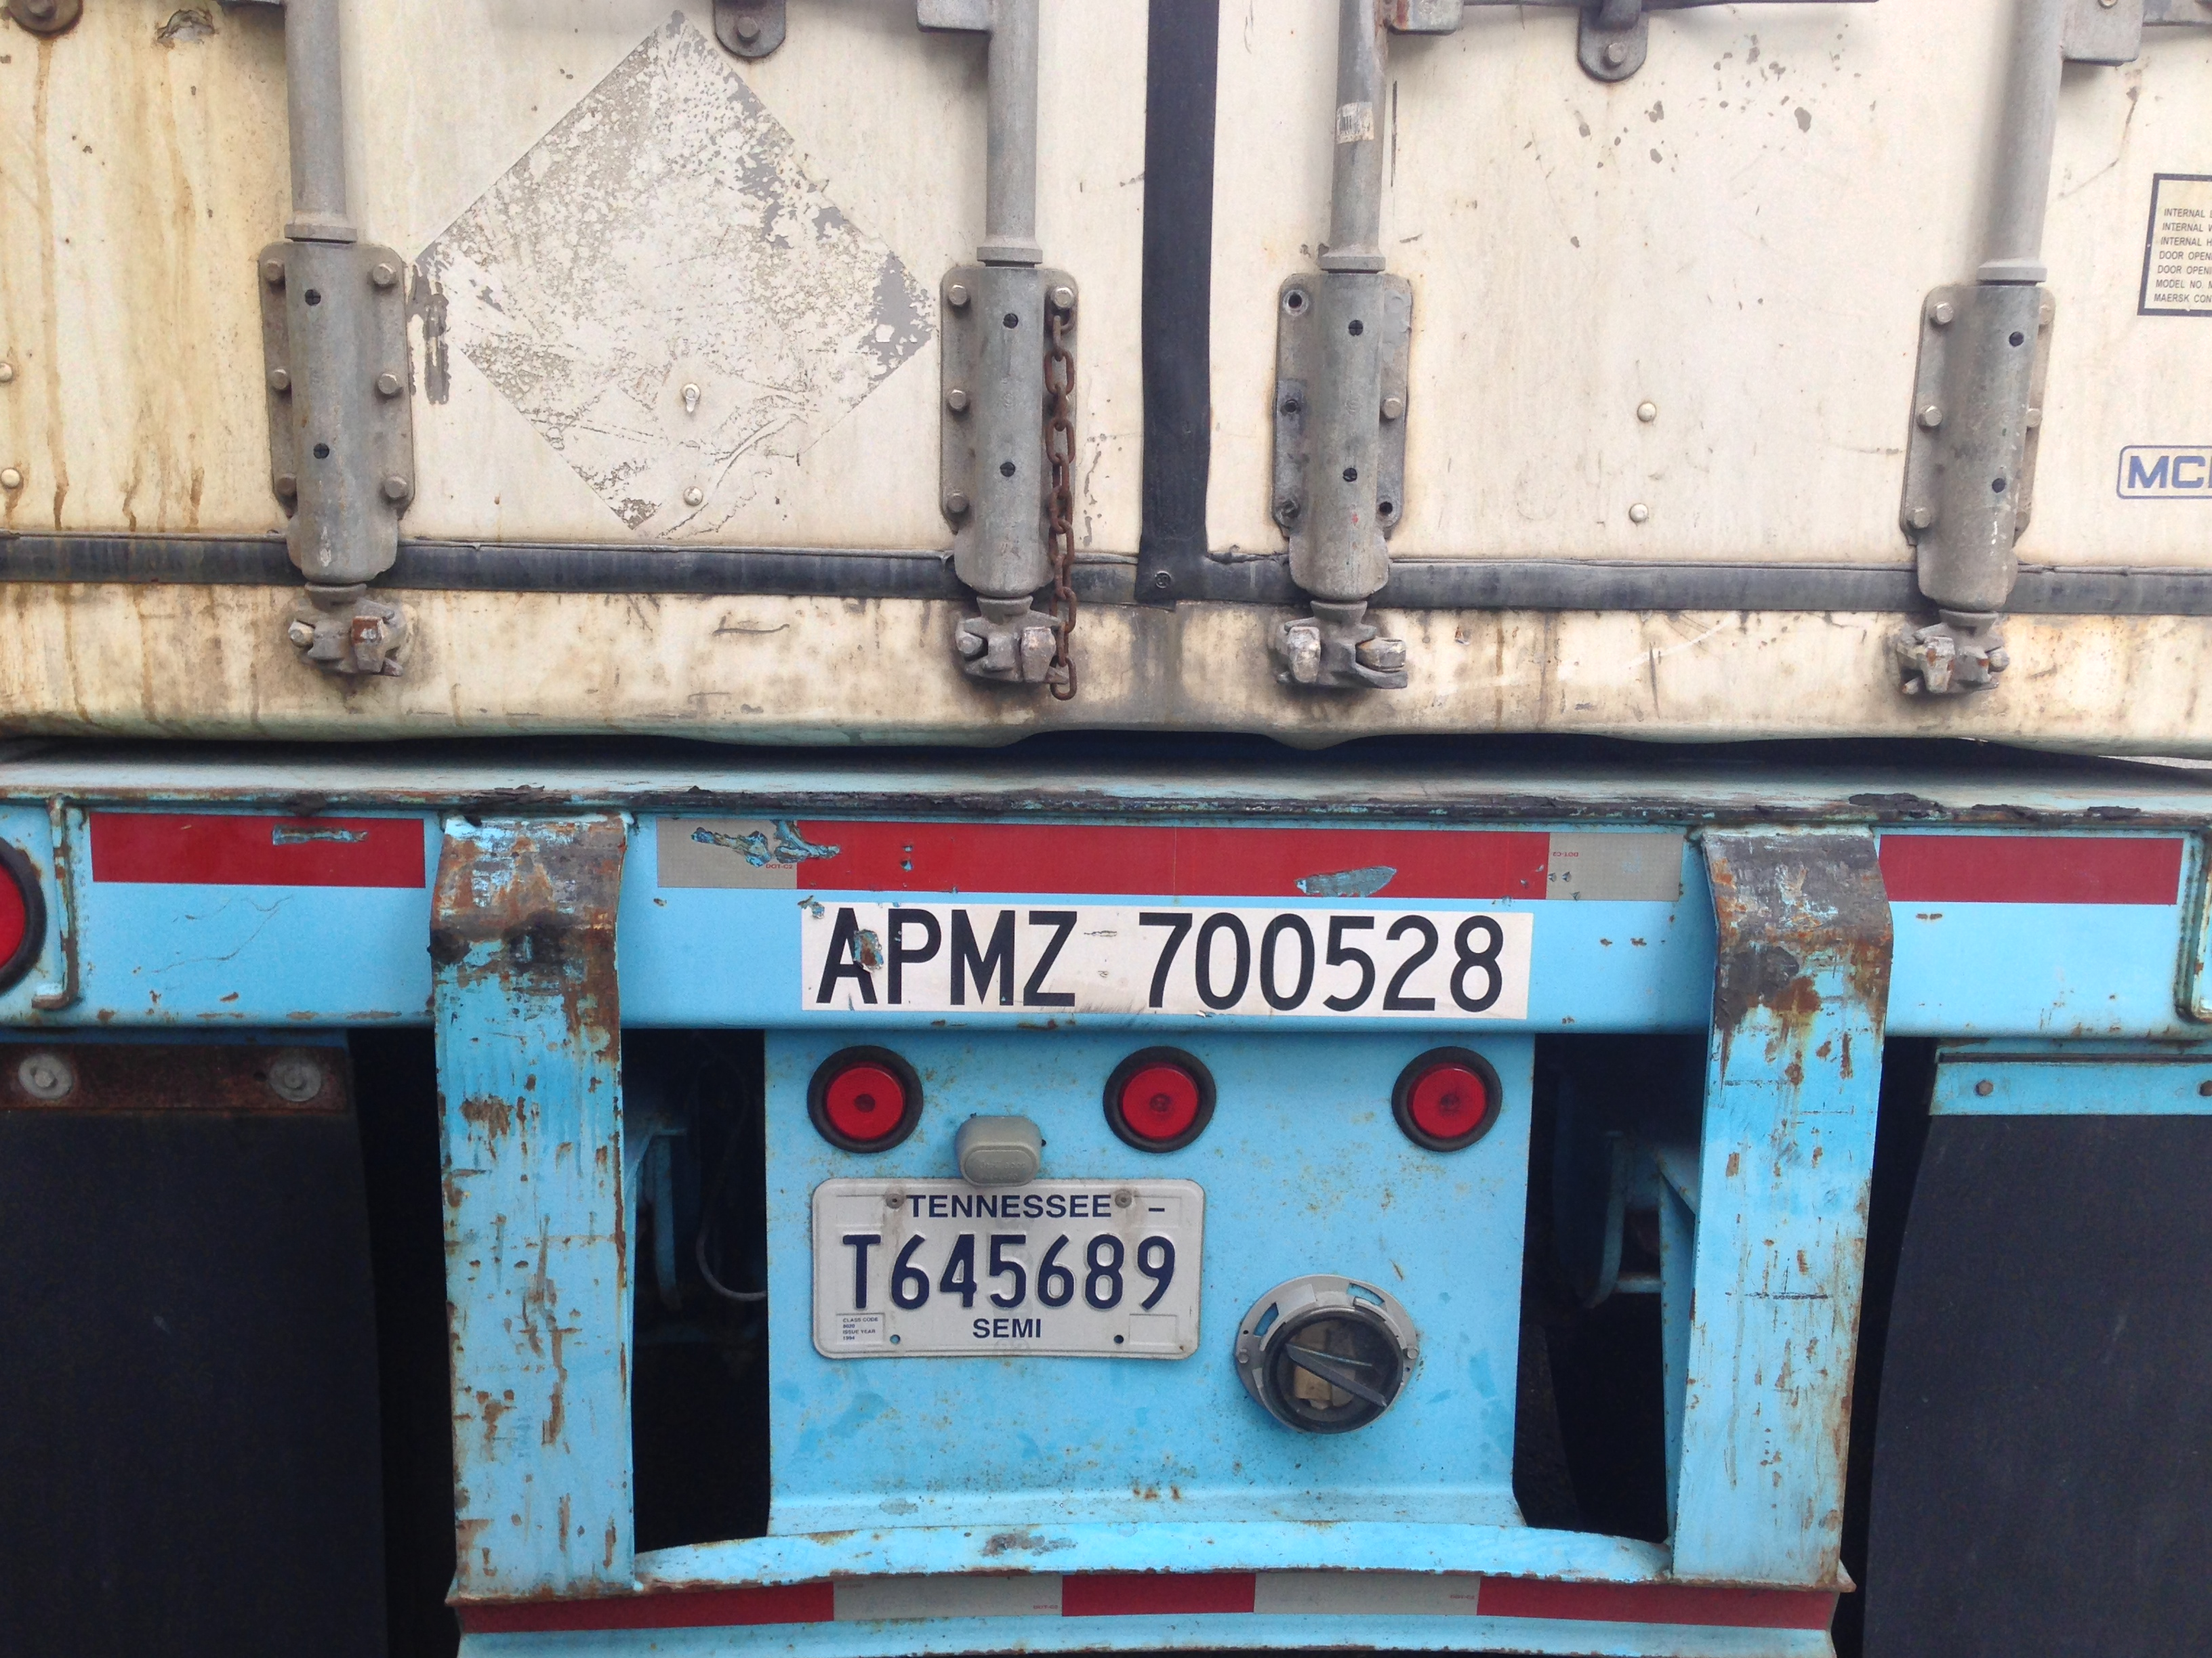
Use case example #4 (Inventory, MTCE, and repair)
Truck Chassis
Manage Current Inventory
Record in real-time Availability & Location
Link all Trailer Inspection records
Track Ongoing Maintenance & Repair

Slide 19
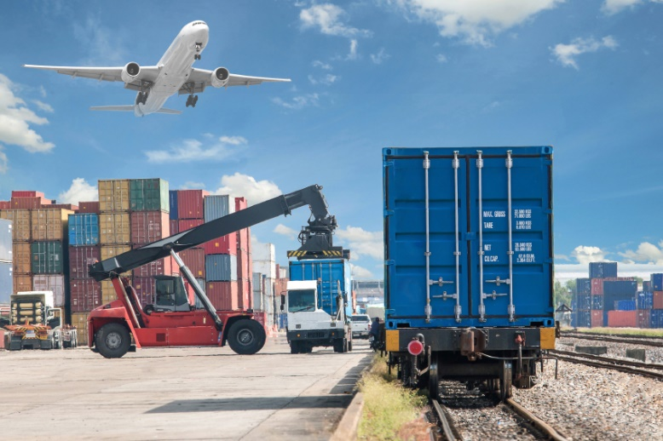
Use case example #5 (Other applications)
Container yard checks and rail yard transfers
OCR can reduce the amount of time spent in the yard
Expands labor productivity to increase the frequency of inspections which will improve inventory management accuracy
Increases yard driver moves and reduces
tractor expenses
Offers real-time verification for inventory
scanned and can alert any discrepancies
from railroad EDI train records received
Enhances load plan accuracy and typically
reduces annual administrative costs due to
errors by 10% or more

Slide 20
What are the additional benefits gained using a Mobile OCR solution
Argosy Mobile is a very low cost alternative to fixed camera systems
Mobile OCR applications are ideally suited for intermodal terminal operators looking to improve asset visibility and tracking
Mobile OCR provides scalable gate control to eliminate backups during peak traffic periods by increasing labor productivity
Increases gate-in capacity greater than 35% without adding additional personnel
Significantly reduces errors caused by manual data entry which can lower your daily administrative costs

Slide 21
What are the additional benefits gained using a Mobile OCR solution (Continued…)
Provides high resolution images for containers, chassis, and safety seals along with location/coordinate which can be easily be linked into your database for each transaction recorded
Automatically detects fraudulent safety seals in real-time
Delivers the highest quality OCR read rates which are typically >95% with errors <2%
Offers complete visibility during chain of custody tracking at points where fixed camera systems are impractical
OCR provides a complete solution which enhances other technologies such as real time location systems or RFID

Slide 22
FOR MORE INFORMATION
PLEASE CONTACT:
Sales@raf.com
or call our office
+1(425) 867-0700
OR VISIT OUR WEBSITE WWW.RAF.COM

Slide 23

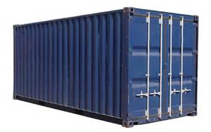
Thank You!
Argosy
Intermodal

